Slide 1
Free3Dm
Ebyan Musse, Gloria Van Trigt, Nazdar Sadik & Kilian De Bock

Slide 2
Free? Not realy, but its a wordplay!
About the assignment.
About the name.
Why this topic?
Workflow & Teamwork.
Some images!

Slide 3
Let’s dive in!

Slide 4

The Assignment
Notes:
pgm5 -> mogelijkheid -> samenwerken -> Technical writers
Webshop maken
Wij kozen enkel engels
Eigen thema kiezen

Slide 5
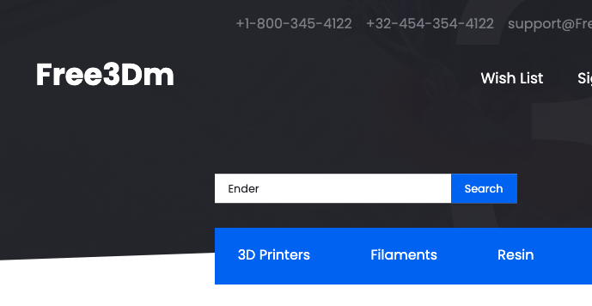
Why that name?
Notes:
FDM -> printer type -> plastic role

Slide 6
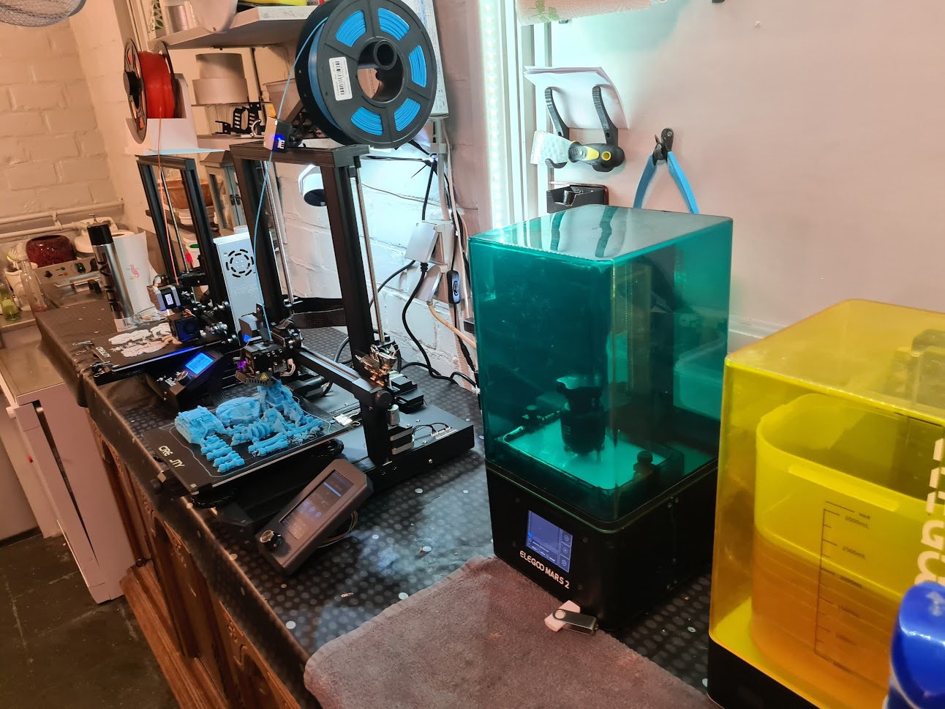
WHy?
Notes:
Thema nodig? Ik hou van printers, dus keuze snel gemaakt.

Slide 7

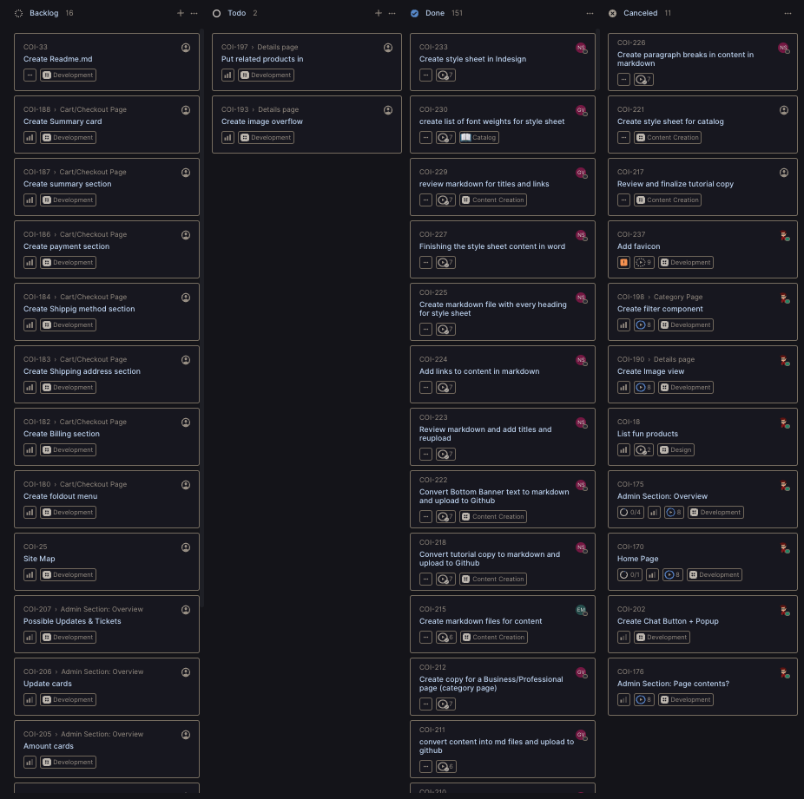
Workflow
Notes:
Each his speciality
Together thinking about the merge point -> how to make it smooth.
Linear, every wednesday
Discord chat
Wednesday Zoom meeting +/- 1.30h (after 17h) I needed to work

Slide 8
Images!

Slide 9
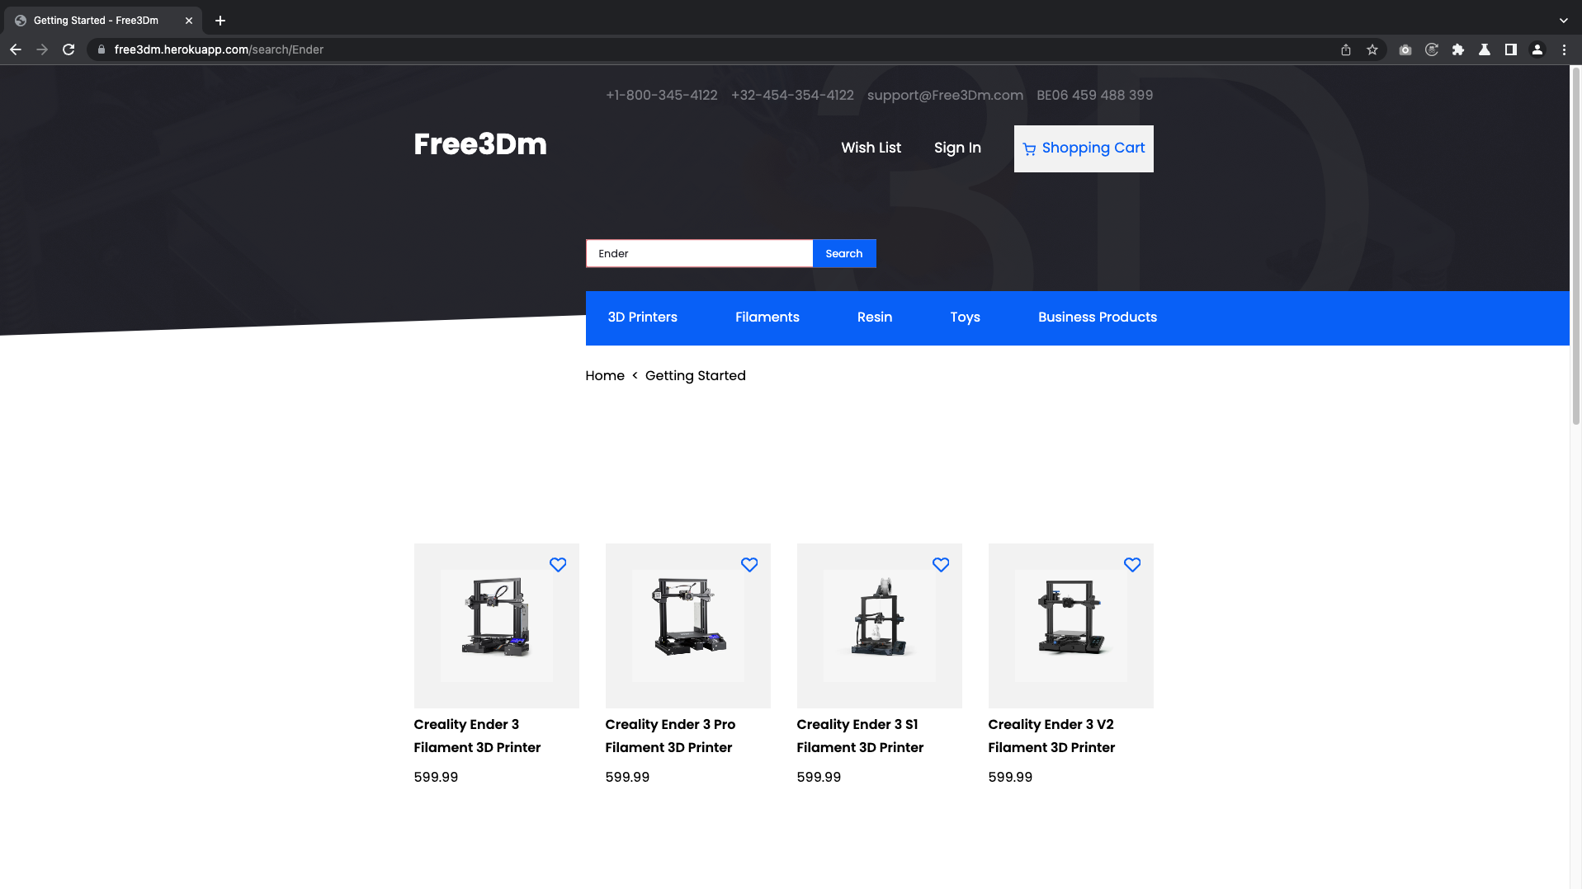

Slide 10
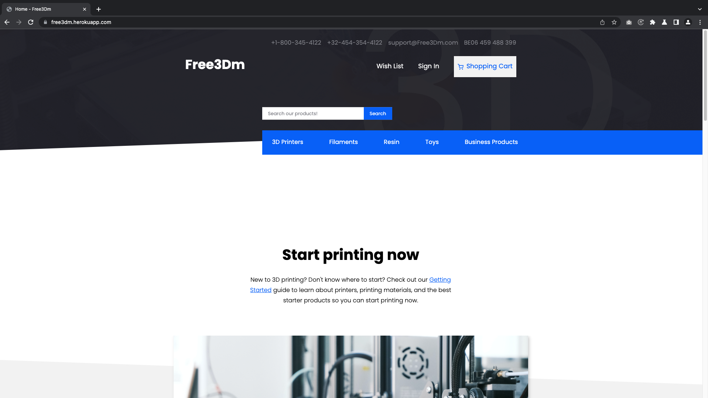

Slide 11
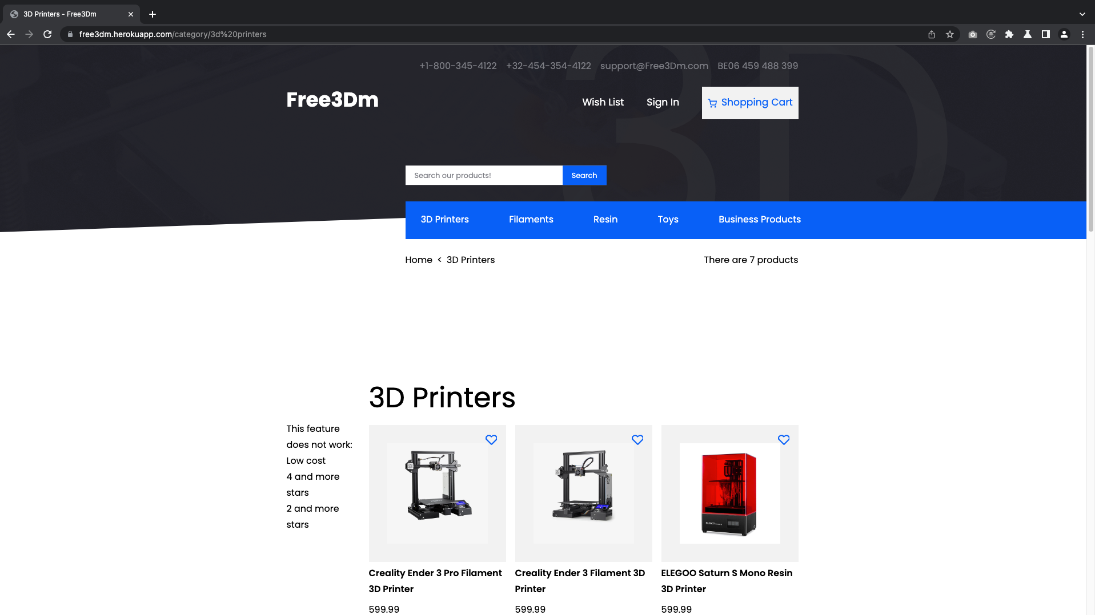

Slide 12
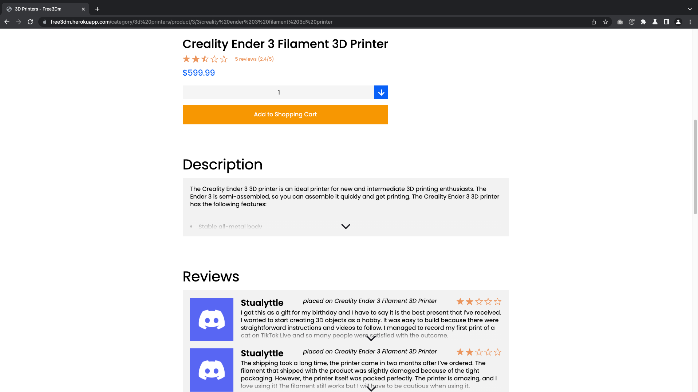

Slide 13
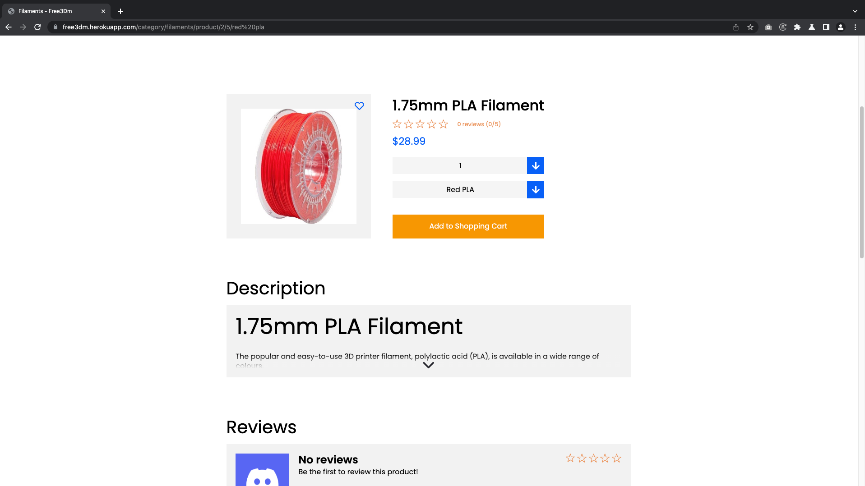

Slide 14
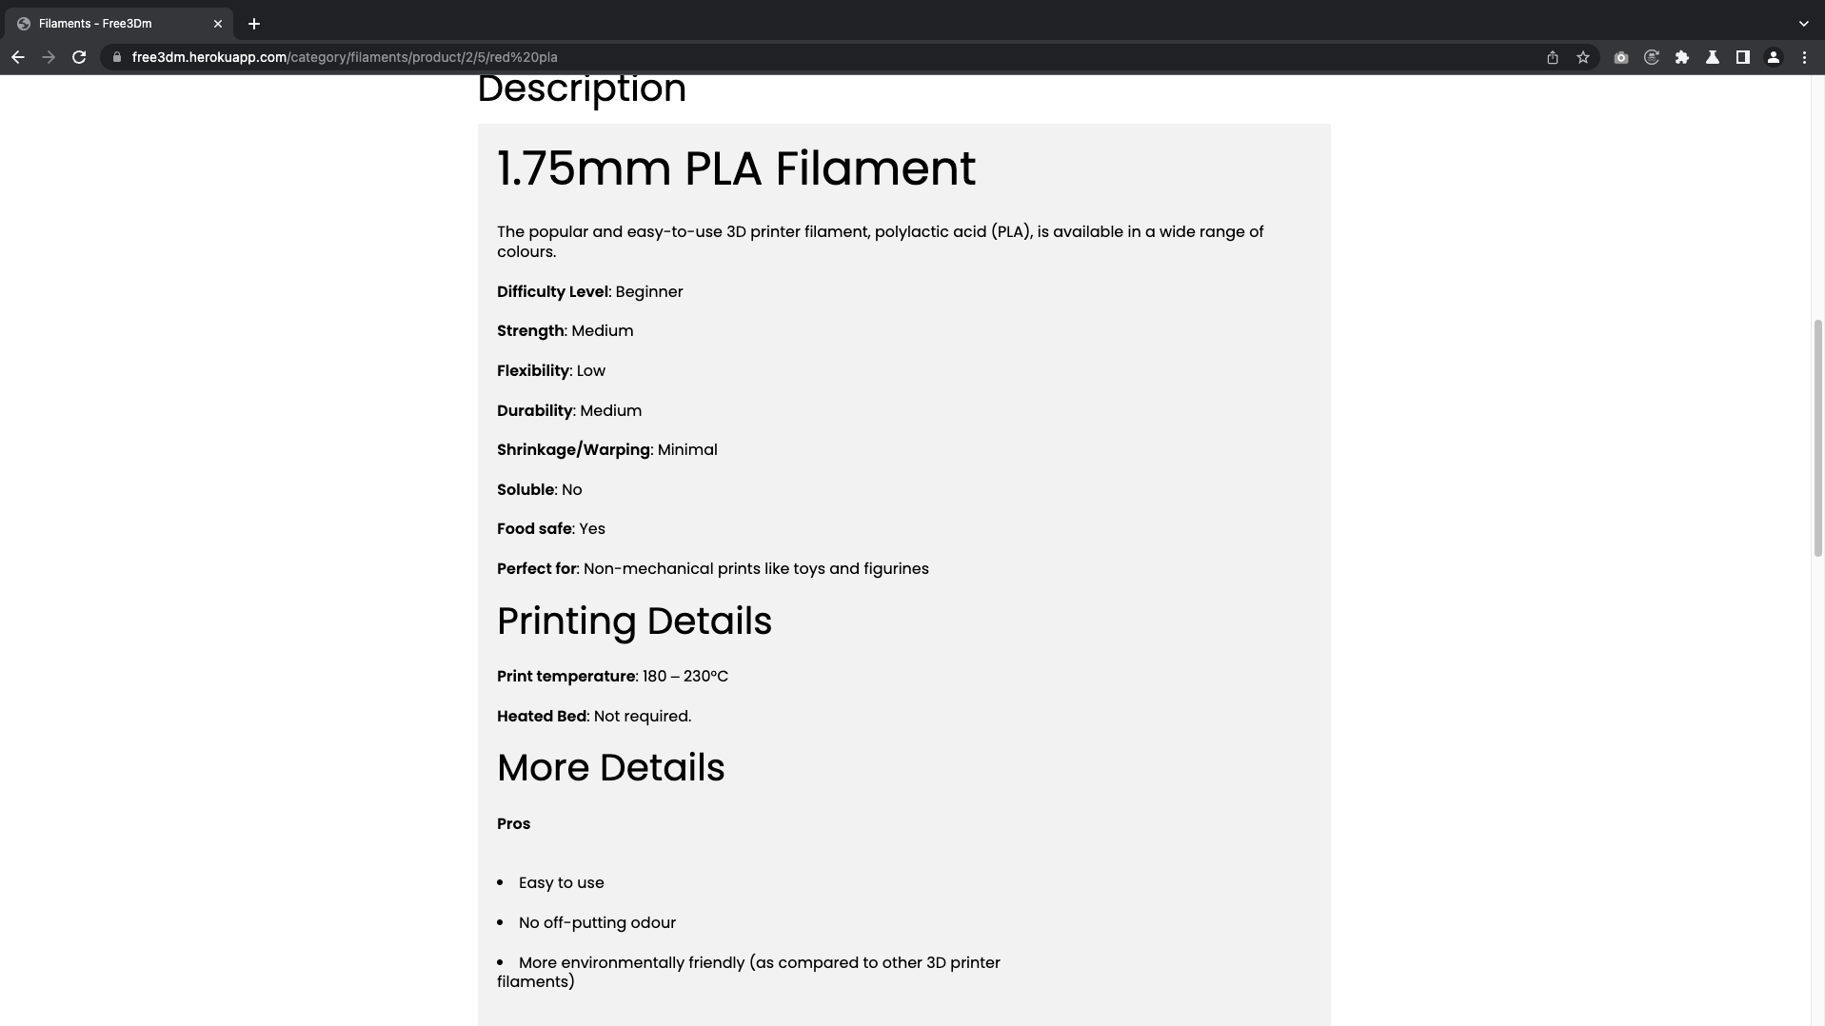

Slide 15
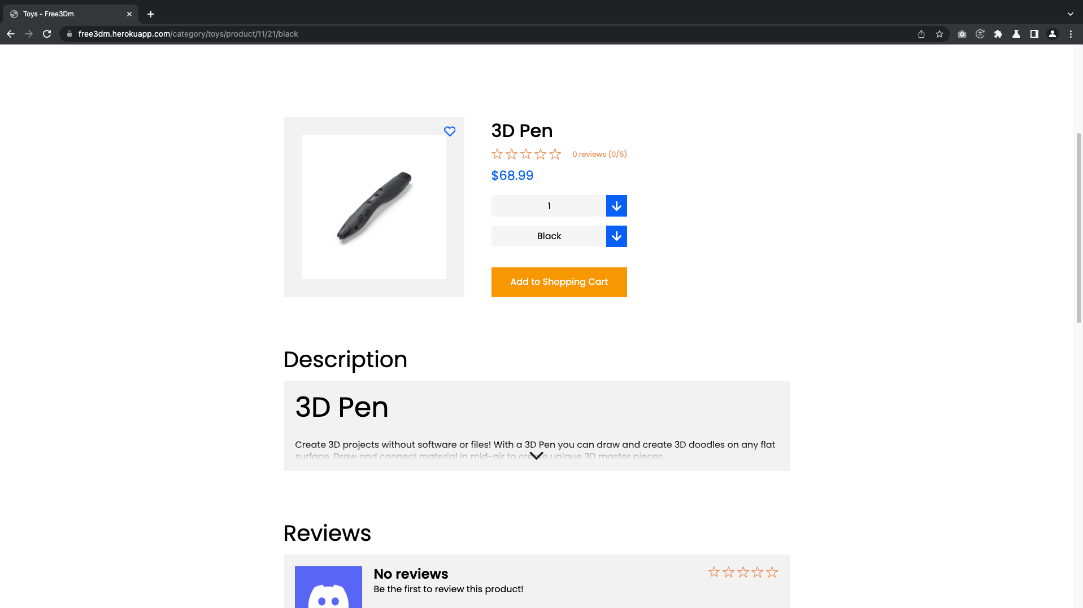

Slide 16
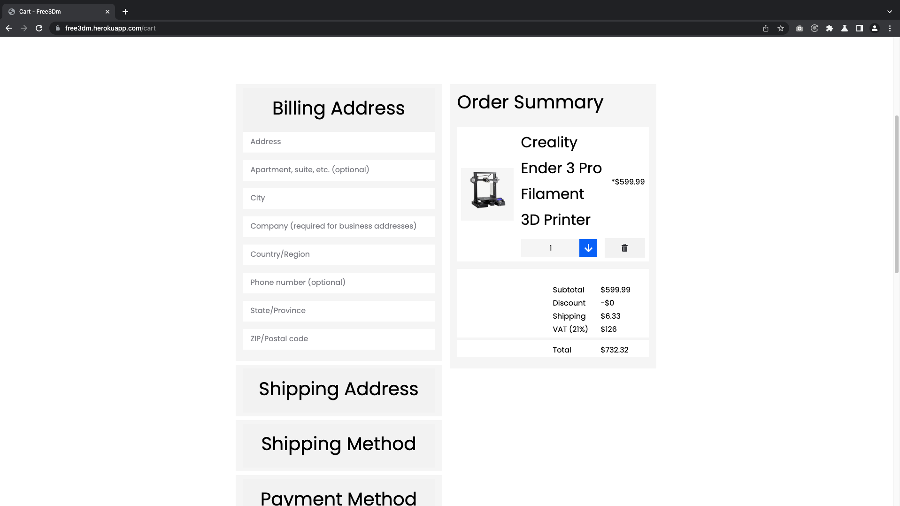

Slide 17
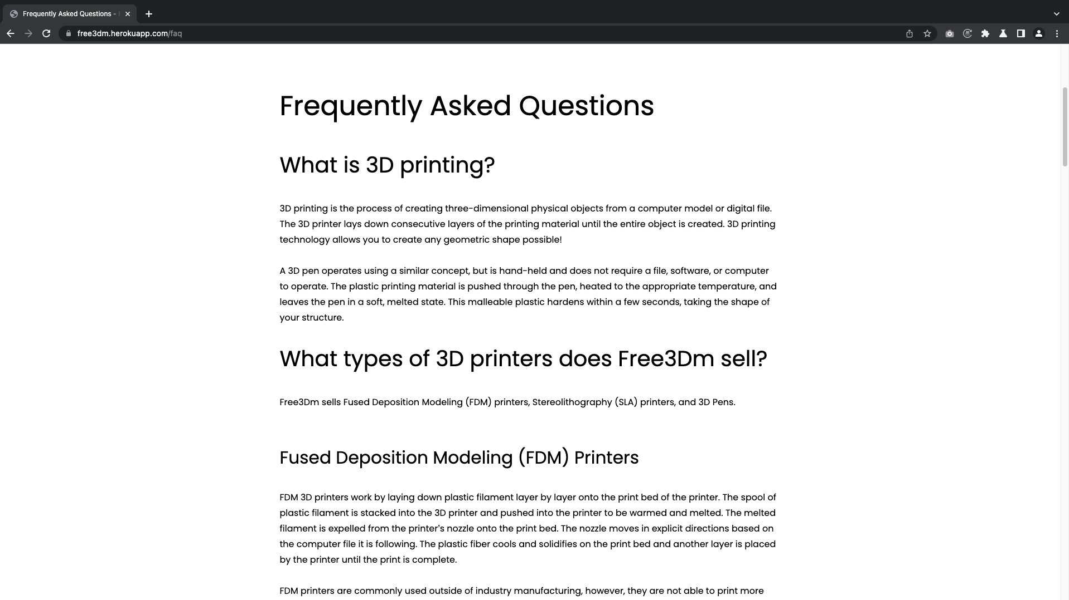

Slide 18
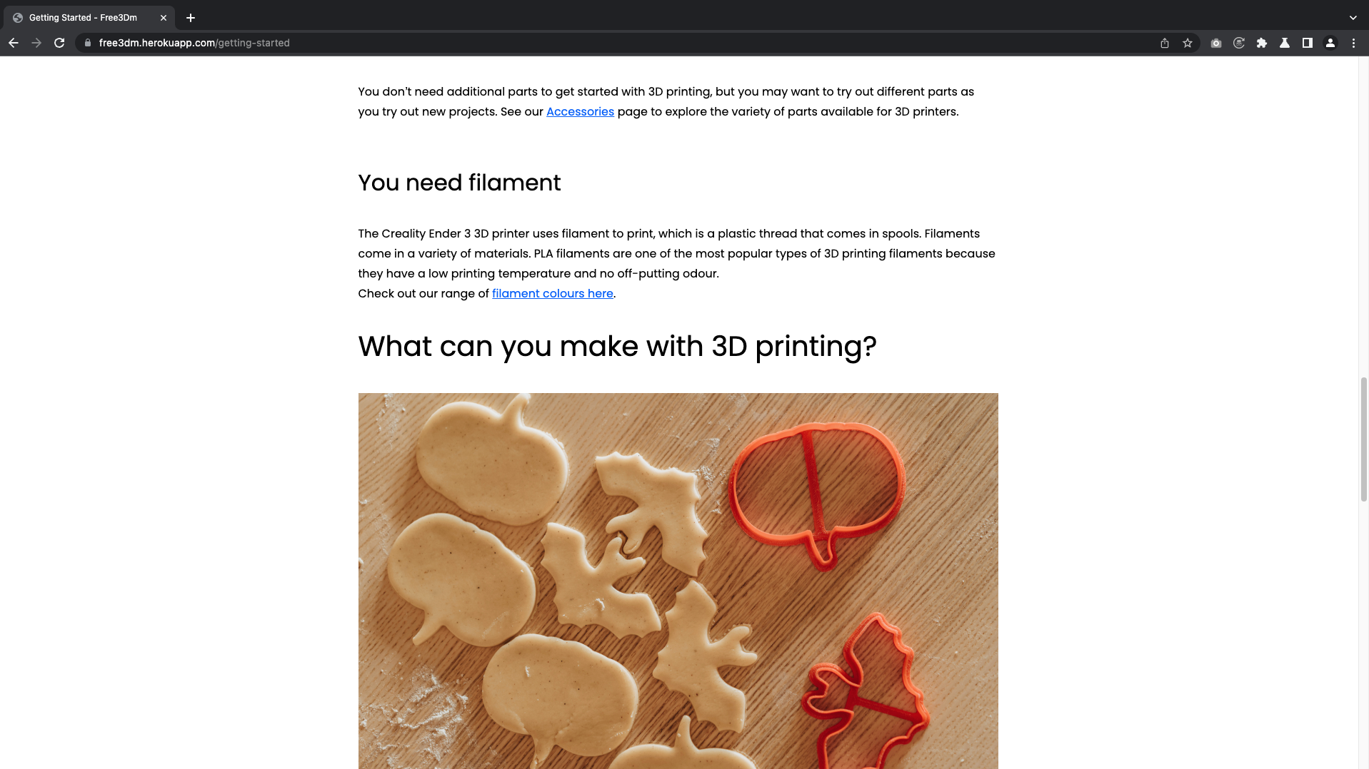

Slide 19
Dat was het! Zijn er nog vragen?

Slide 20
Our TEAM name: Naebgaki (Na-eb-ga-ki)

